Slide 1
Kinematics and Dynamics of Robots
Spring Semester 2021
Lecturer: Yoav Golan

Slide 2
CORRECTION
Link Length
The distance from frame {i} to frame {i-1} in the X_{i} axis direction
The distance from frame {i-1} to frame {i} in the X_{i} axis direction

Slide 3
Drawing DH Frames
Rules:
There must be at least n+1 frames for n joints. The end effector must have a frame.
The Z axis must be the axis of revolution or the direction of prismatic movement

Slide 4
Drawing DH Frames
Rules:
3. The X axis must be perpendicular to the Z axis of the frame before it
4. The X axis must intersect the Z axis of the frame before it
5. The Y axis is drawn by the right-hand rule

Slide 5
Deriving the DH Parameters
Joint angle
The amount we have to rotate the frame i-1 about the Z_{i-1} axis so that X_{i-1} and X_{i} are parallel
PLUS
the revolution of a revolute joint

Slide 6
Deriving the DH Parameters
Joint twist
The amount we have to rotate the frame i-1 about the X_{i} axis so that Z_{i-1} and Z_{i} are parallel

Slide 7
Deriving the DH Parameters
Link Length
The distance from frame {i-1} to frame {i} in the X_{i} axis direction

Slide 8
Deriving the DH Parameters
Link Offset
The distance from frame {i} to frame {i-1} in the Z_{i-1} axis direction

Slide 9
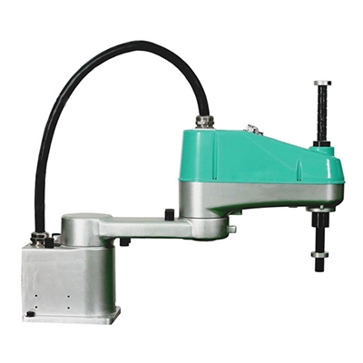
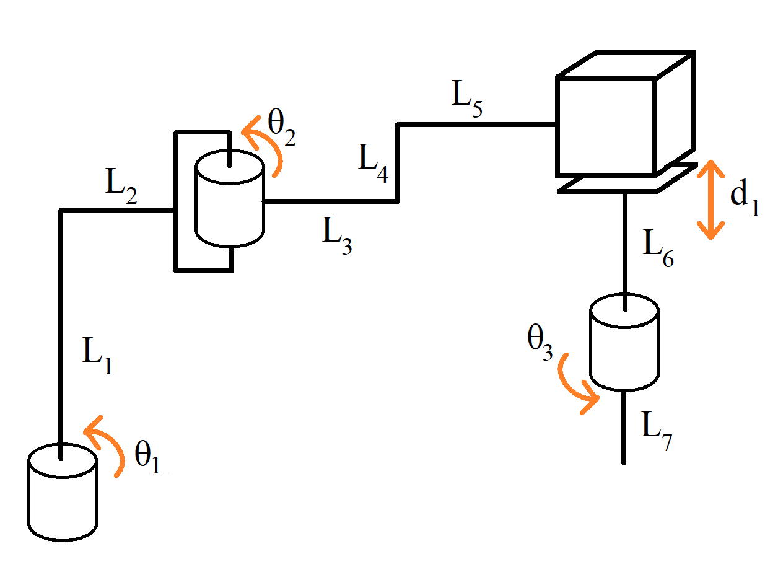
Drawing DH Frames

Slide 10
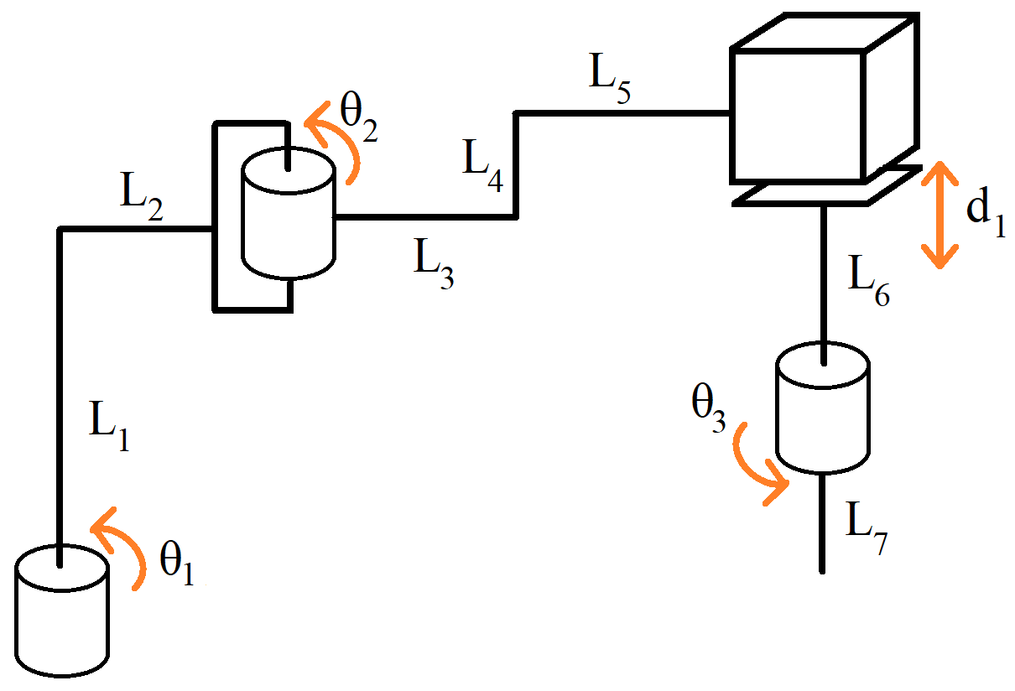
Drawing DH Frames
Z₂
Z₁
Z₃
Z₀
Z₄

Slide 11
Drawing DH Frames
Z₂
Z₁
X₂
X₁
Z₃
X₃
Z₀
X₀
X₄
Z₄

Slide 12
Drawing DH Frames
Z₂
y₂
Z₁
X₂
y₁
X₁
Z₃
y₃
X₃
Z₀
y₀
X₀
X₄
y₄
Z₄

Slide 13
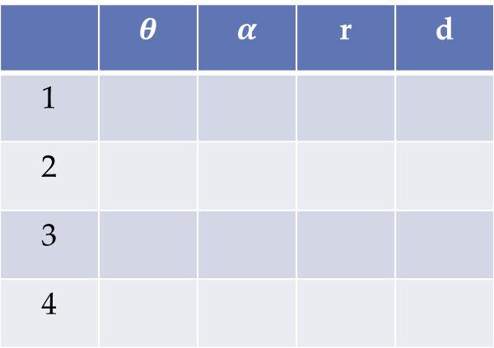
Class Problem #4
Z₂
Z₁
y₂
 | $$θ$$ | $$α$$ | r | d
1
2
3
4
y₁
X₂
X₁
Z₃
y₃
y₀
X₃
Z₀
X₀
X₄
y₄
Z₄

Slide 14



Class Problem #4
Z₂
Z₁
y₂
 | $$θ$$ | $$α$$ | r | d
1
2
3
4
y₁
X₂
0+$θ_{1}$
0
L₂
L₁
X₁
Z₃
0+$θ_{2}$
0
L₃+L₅
L₄
y₃
0
0
0
-L₆-d₁
y₀
X₃
Z₀
0+$θ_{3}$
180
0
-L₇
X₀
X₄
y₄
Z₄

Slide 15
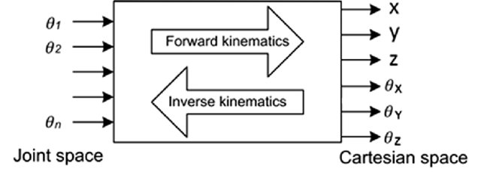
Inverse Kinematics

Slide 16
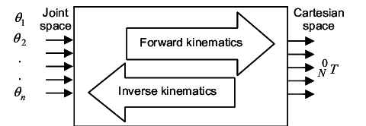
Inverse Kinematics

Slide 17
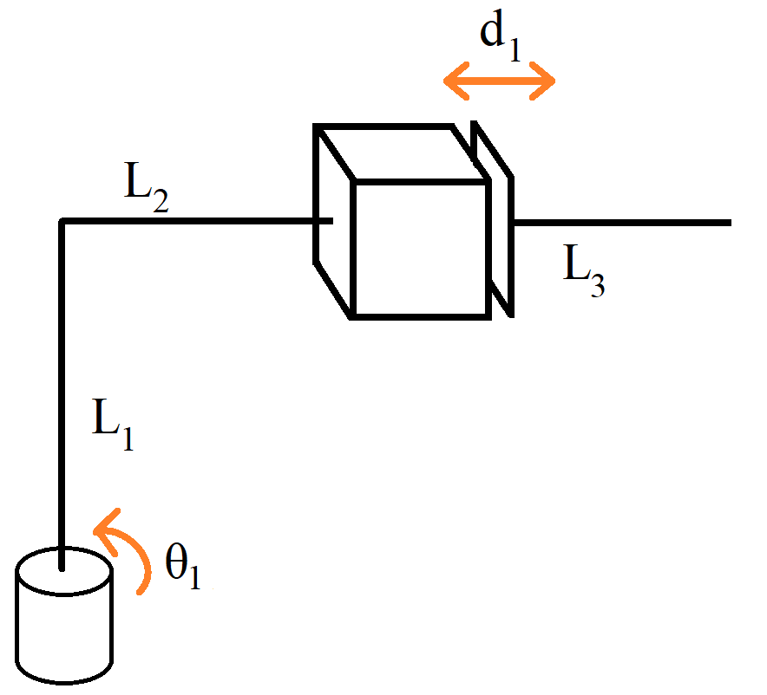
Inverse Kinematics
y₂
y₁
X₁
X₂
Z₂
Z₁
Z₀
y₀
X₀

Slide 18
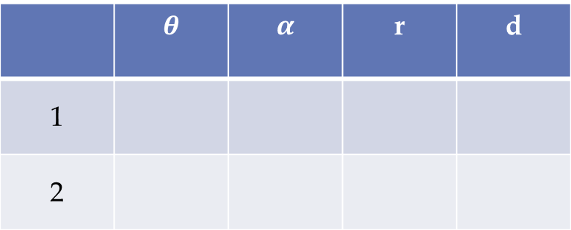

Inverse Kinematics
y₂
y₁
X₁
X₂
Z₂
Z₁
 | $$θ$$ | $$α$$ | r | d
1
2
Z₀
y₀
90+$θ_{1}$
90
0
L₁
X₀
0
0
0
L₂+L₃+d₁

Slide 19

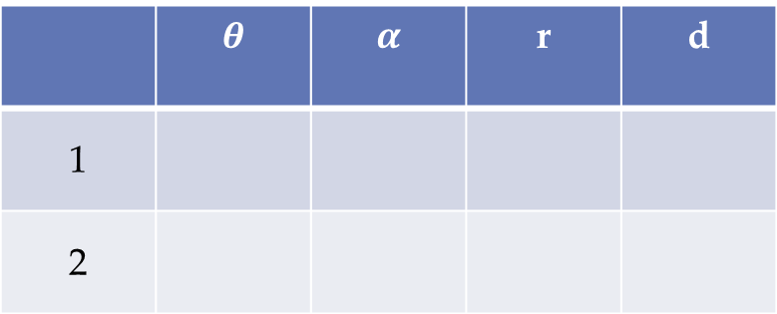
Inverse Kinematics
 | $$θ$$ | $$α$$ | r | d
1
2
90+$θ_{1}$
90
0
L₁
0
0
0
L₂+L₃+d₁

Slide 20
Inverse Kinematics

Slide 21
Inverse Kinematics

Slide 22
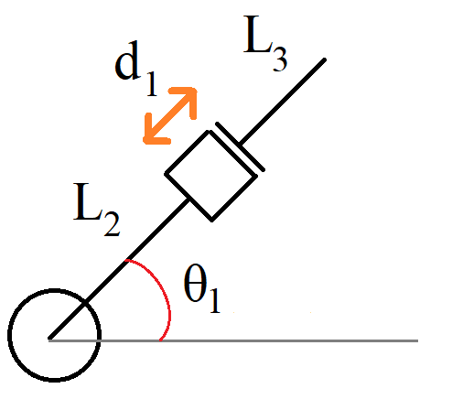
Inverse Kinematics
y₂
y₁
X₁
X₂
Z₂
Z₁
Z₀
y₀
X₀
y₀
X₀

Slide 23
Inverse Kinematics
y₀
X₀

Slide 24
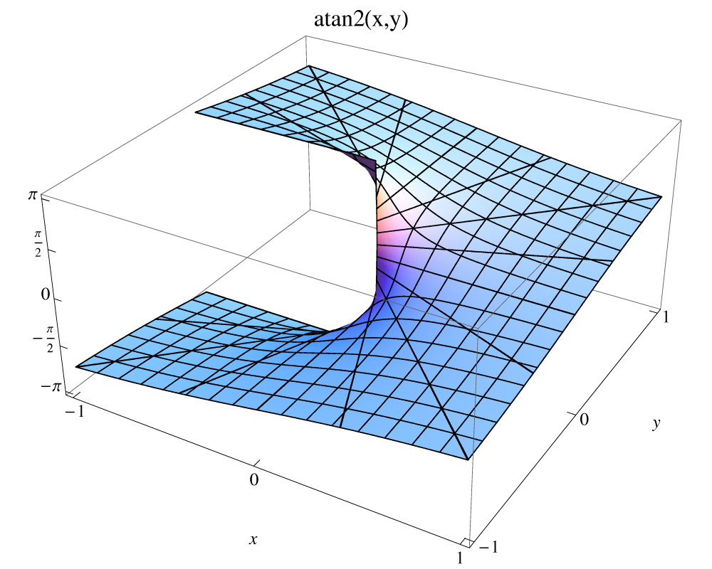
Inverse Kinematics
arctan vs arctan2

Slide 25
Inverse Kinematics
y₀
X₀

Slide 26
The Jacobian Matrix

Slide 27
The Jacobian Matrix

Slide 28
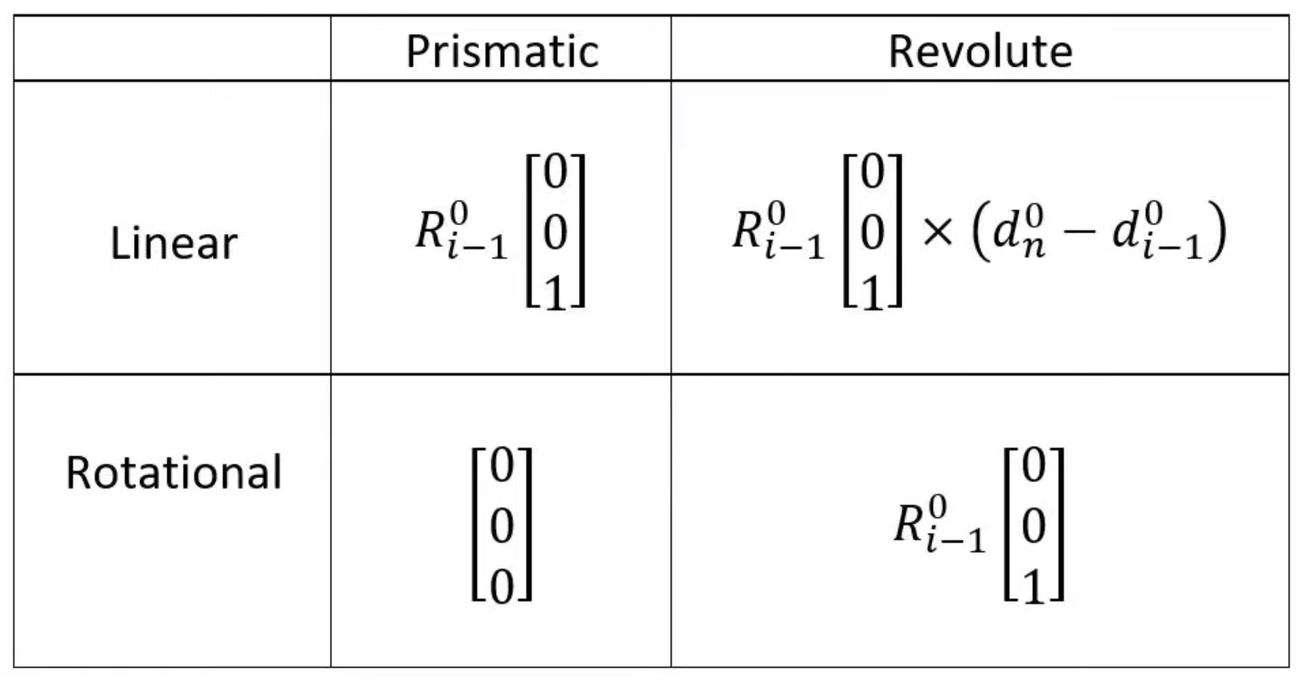
The Jacobian Matrix
The easy way

Slide 29
The Jacobian Matrix
y₂
y₁
X₁
X₂
Z₂
Z₁
 | $$θ$$ | $$α$$ | r | d
1
2
Z₀
y₀
90+$θ_{1}$
90
0
L₁
X₀
0
0
0
L₂+L₃+d₁

Slide 30

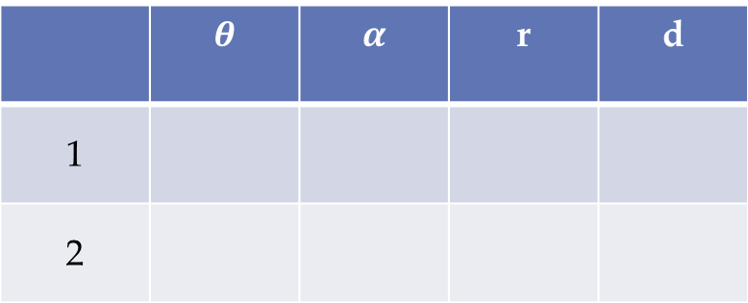
The Jacobian Matrix
y₂
 | $$θ$$ | $$α$$ | r | d
1
2
y₁
X₁
X₂
Z₂
90+$θ_{1}$
90
0
L₁
Z₁
0
0
0
L₂+L₃+d₁
Z₀
y₀
X₀

Slide 31
The Jacobian Matrix

Slide 32
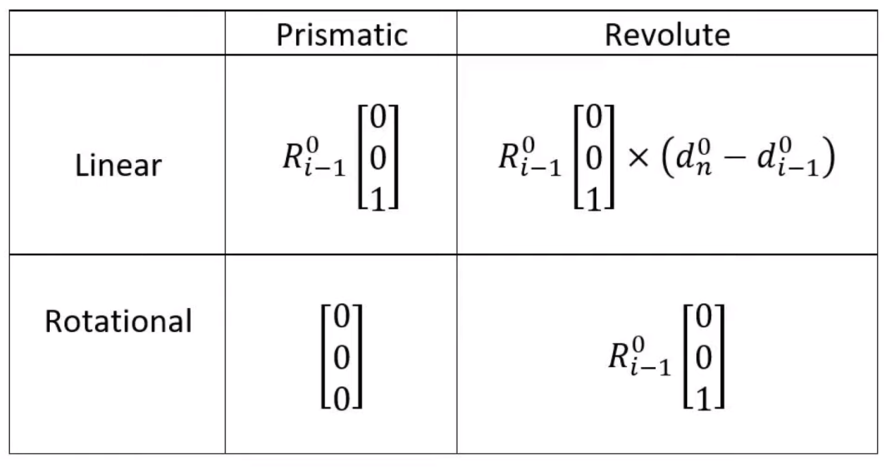
The Jacobian Matrix

Slide 33

The Jacobian Matrix

Slide 34
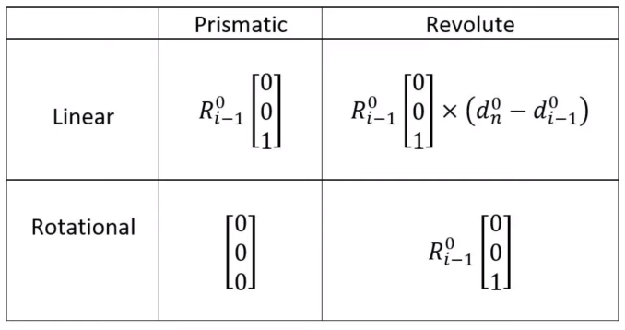
The Jacobian Matrix

Slide 35

The Jacobian Matrix

Slide 36
The Jacobian Matrix

Slide 37
The Jacobian Matrix

Slide 38
The Jacobian Matrix

Slide 39
The Jacobian Matrix

Slide 40
The Jacobian Matrix
y₂
y₁
X₁
X₂
Z₂
Z₁
Z₀
y₀
X₀

Slide 41
Kinematic Singularities
Basically: A finite end-effector speed requires infinite joint speed

